Slide 1
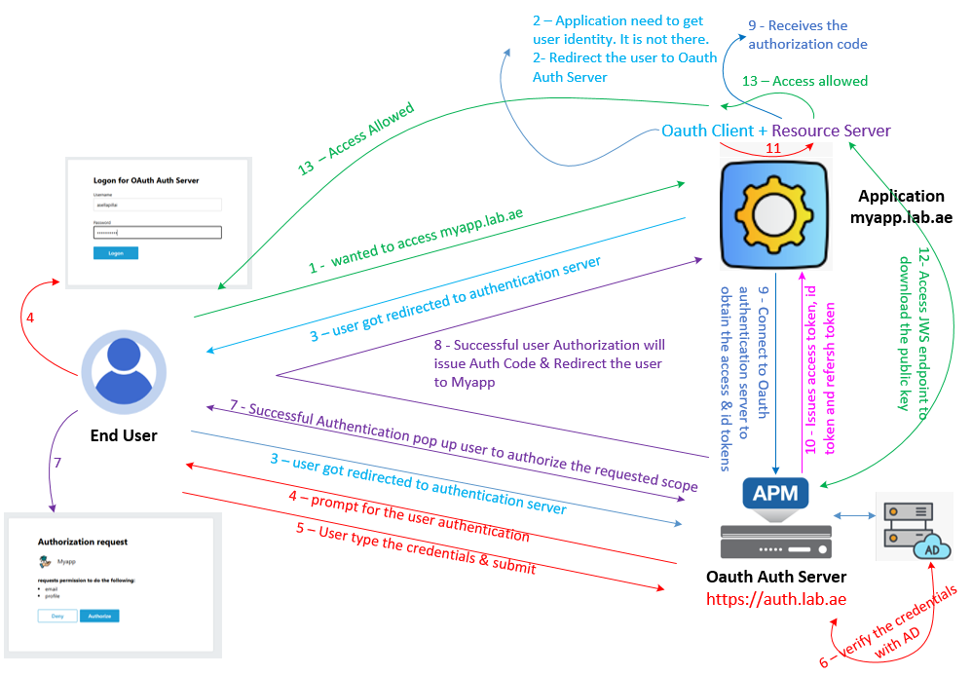


F5 APM Learning with
Alexander S
Chapter 02 – F5 APM functions as an Authorization Server using the OpenID Connect Authorization Code Flow

Slide 2
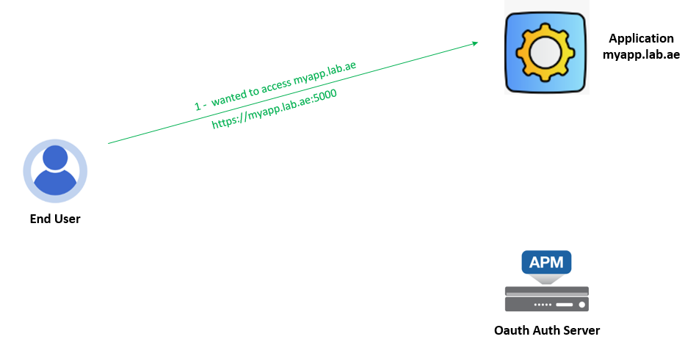
    Step 01 : User connect myapp.lab.ae
The user opens secure web application (for example, https://myapp.lab.ae:5000) from the web browser.
The user request reaches to the web server.

Slide 3
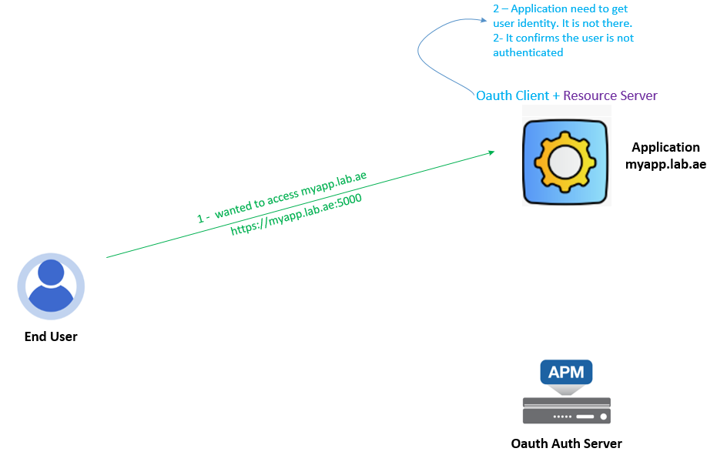
    Step 02 : MyApp application validate the request and found the user is not authenticated
MyApp receives and checks the incoming user request.
It’s a new request, and MyApp needs to know who the user is, but the request doesn't contain any user identity information yet.
Since this is a publicly accessible but secure web application, the user must be authenticated to access protected resources.
At this point, the user is not authenticated.

Slide 4
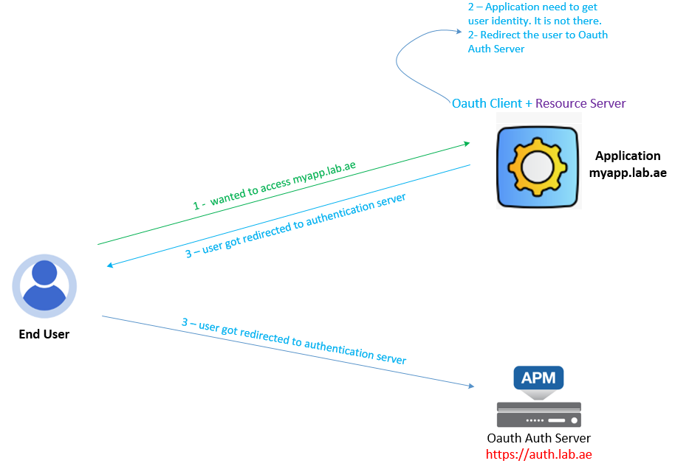
    Step 02 : MyApp application redirect the users to authenticate using oAuth Authorization Server
MyApp is configured as both an OAuth Client and a oAuth Resource Server.
If the user is not authenticated, the OAuth Client role is responsible for redirecting the user to the OAuth Authorization Server for authentication.
This Oauth Client Configuration includes the following details:
  Authorization Server URL
  Client ID: The unique identifier for client to connect Authorization server. It is created in Oauth Authorization server and shared it with the Oauth client
  Response Type: Specifies what type of response the client expects from the server. In our case, since this is a web application, we are using the Authorization Code Flow, which is considered the most secure method.
  Scope: Defines what information (claims) will be retrieved after successful authentication.
  Redirect URI: the URL where the client will be redirected after successful authentication.

Slide 5
    Step 02 : MyApp application redirect the users to authenticate using oAuth Authorization Server
MyApp is configured as both an OAuth Client and a oAuth Resource Server.
If the user is not authenticated, the OAuth Client role is responsible for redirecting the user to the OAuth Authorization Server for authentication.
This Oauth Client Configuration includes the following details:
  Authorization Server URL
  Client ID: The unique identifier for client to connect Authorization server. It is created in Oauth Authorization server and shared it with the Oauth client
  Response Type: Specifies what type of response the client expects from the server. In our case, since this is a web application, we are using the Authorization Code Flow, which is considered the most secure method.
  Scope: Defines what information (claims) will be retrieved after successful authentication.
  Redirect URI: the URL where the client will be redirected after successful authentication.
https://auth.lab.ae/f5-oauth2/v1/authorize?response_type=code&client_id=d3758e21a7f77aa86f11ec716337000c29a926b1e94f3f68&redirect_uri=https://myapp.lab.ae:5000/callback&scope=openid%20email%20profile
Authorize URL : https://auth.lab.ae/f5-oauth2/v1/authorize
Oauth response type : code
Client_id : d3758e21a7f77aa86f11ec716337000c29a926b1e94f3f68
Scope : openid email profile
Redirect_uri : https://myapp.lab.ae:5000/callback

Slide 6
    Step 02 : MyApp application redirect the users to authenticate using oAuth Authorization Server
We have configured the Oauth Client (Which is our MyApp server) with all the details and it is redirecting the user to Oauth Auth Server.

Slide 7
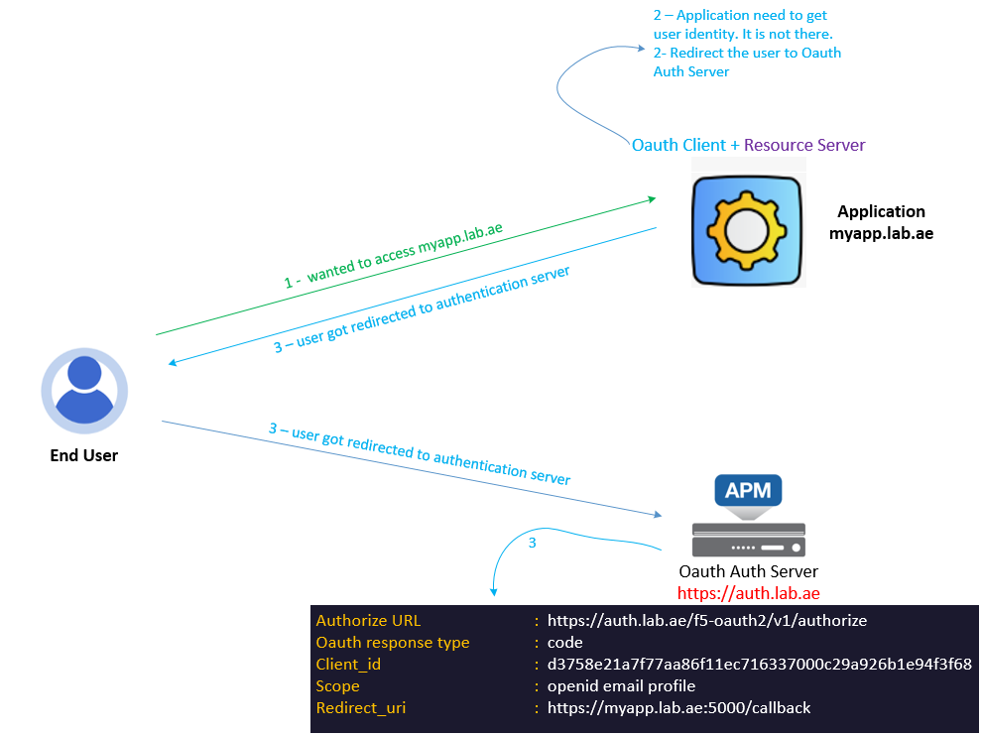
    Step 03 : Oauth Authorization Server receives and verify the request
Oauth Authorization Server receives and verify the Oauth Client Request.
  Is the oAuth Client ID valid?
  Is the oAuth response type correct?
  Is the oAuth client registered for this service?
  For the client to be properly registered, its redirect URI must be added to the oAuth Authorization Server’s client configuration.
If any of these checks fail, the oAuth Authorization server will return an error.

Slide 8
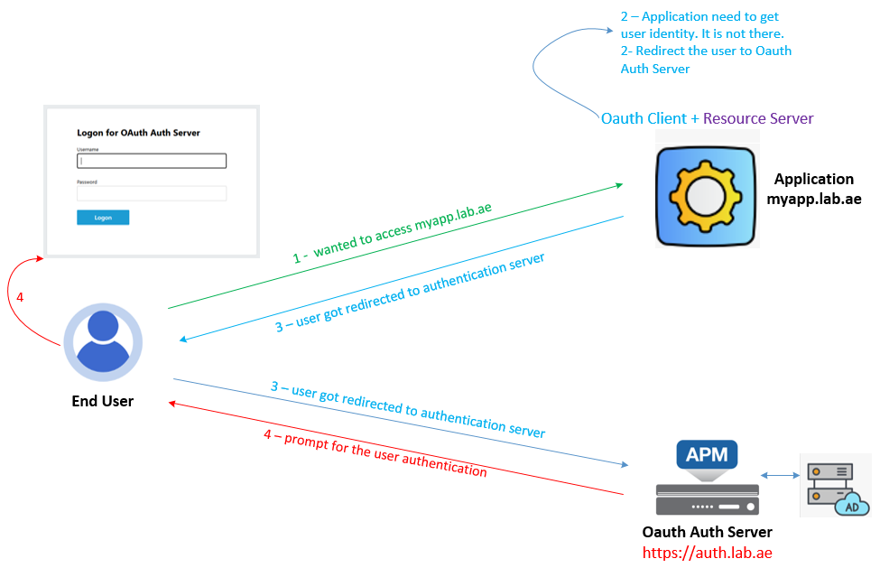
    Step 04 : Successful verification prompt for user authentication
The OAuth Authorization Server successfully verifies the OAuth client request.
This means it’s a valid request from a trusted OAuth client, and the Authorization Server now needs to generate a response.
To do that, it requires user identity details — which it doesn't have yet.
So, the OAuth Authorization Server prompts the user for authentication to collect those details.
In our case, form-based authentication is used for this step.

Slide 9
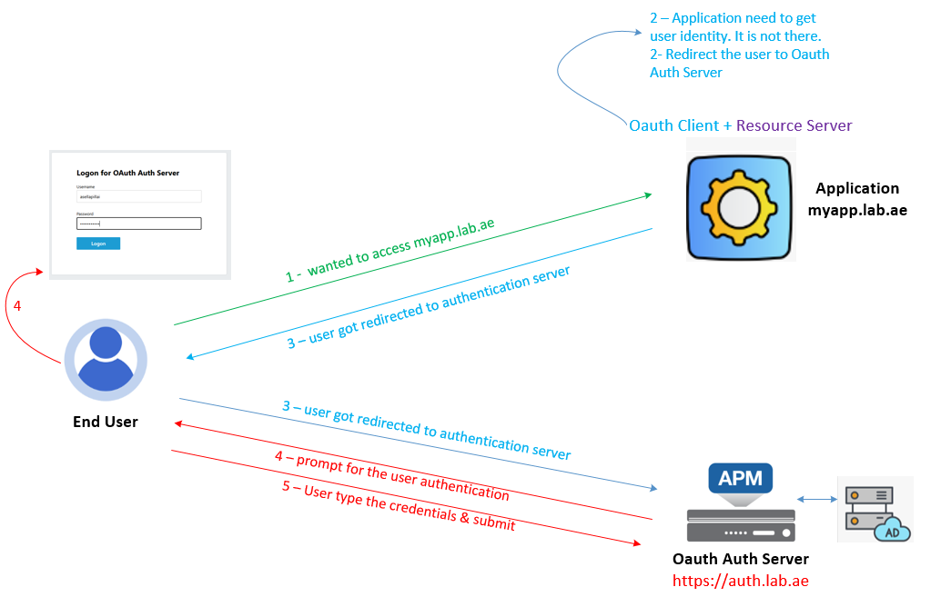
    Step 05 : Users type the credentials and submit for the authentication
User type his login credentials into the form and click submit for the authentication.

Slide 10
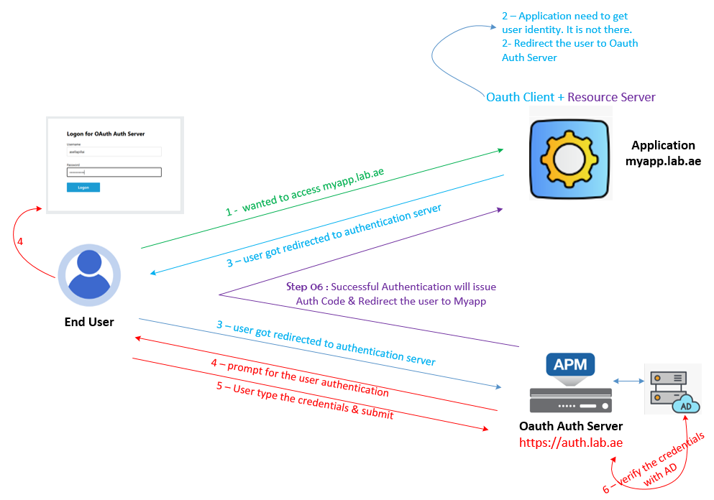
    Step 06 : Auth Server verify the user credentials with AD
The oAuth Authorization server receives the user credentials and verify it with Active Directory.

Slide 11
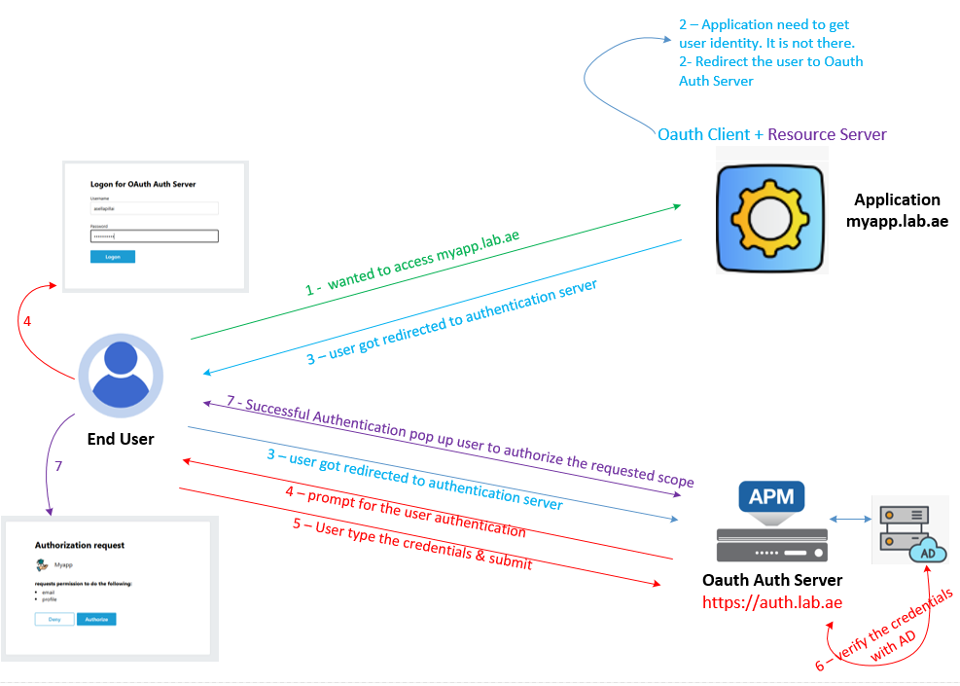
    Step 07: Successful Authentication will issue pop up user to authorize the requested scope
✅ The OAuth Authorization Server receives the credentials. Also, validate and confirms that user authentication is successful
❗But that's not enough — because MyApp wants to access user data like profile and email
So - the server informs the user and asks for approval
💬 The Authorization Server displays a consent screen:
"Hey user, myapp.lab.ae wants to access your email and profile. Do you approve?"
(Approve / Deny)
❌ If the user denies access:
  They are redirected back to myapp.lab.ae
  With an error: access_denied

Slide 12
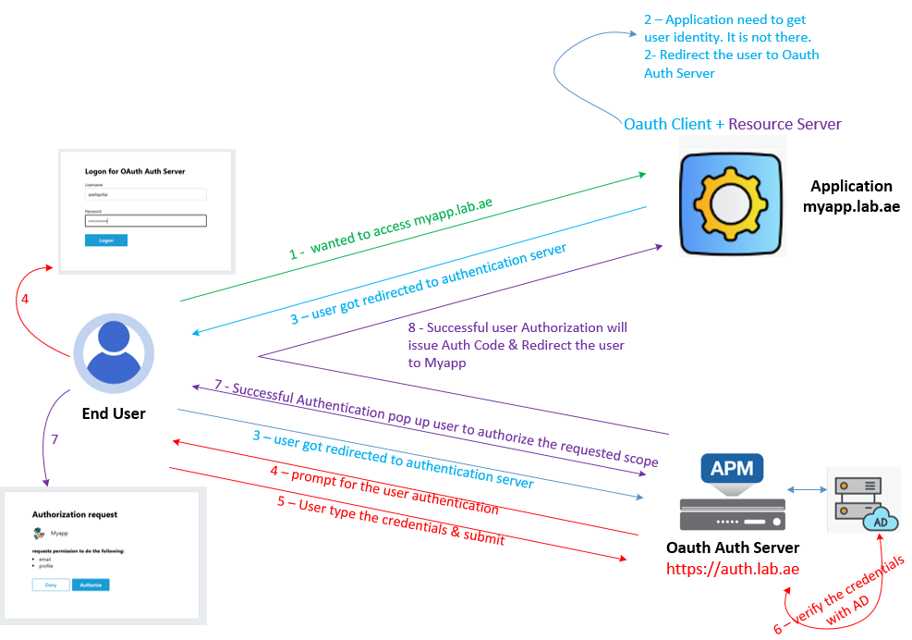
    Step 08: Successful user Authorization will issue Auth Code & Redirect the user to Myapp
    If user authorize then, the oAuth Authorization server issues an Authorization Code and redirects the user to the myapp.lab.ae redirect URI.

Slide 13
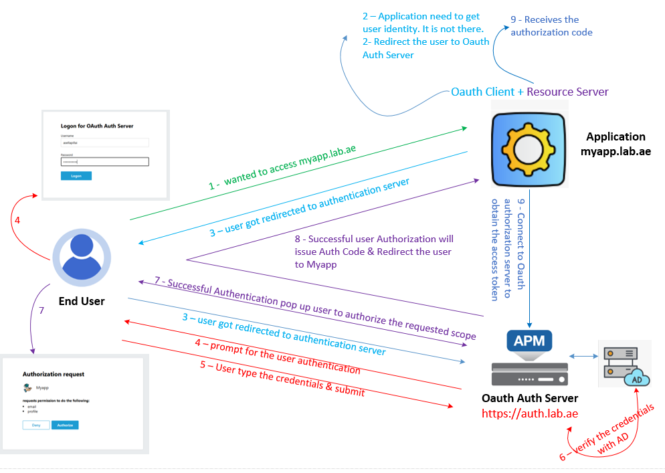
    Step 09: The OAuth Client receives the authorization code and sends a token request to the Authorization Server to obtain an access token and an ID token (as part of OpenID Connect)
The OAuth client receives the authorization code and connects to the OAuth Authorization Server to obtain an access token and an ID token.
In OpenID Connect, the ID token is mandatory because it contains the user's identity information and is essential for user authentication.

Slide 14
    Step 09: The OAuth client receives the authorization code and sends a token request to the authorization server to obtain an access token and an ID token (as part of OpenID Connect)
    To get this - oAuth client sends a POST request to the Authorization Server’s Token Endpoint. It includes:
      The authorization code received from the previous step
      The client ID and client secret (for authentication)
      The redirect URI (must match the one used earlier)
      The grant_type=authorization_code
      Important:
        The MyApp server must trust the Authorization Server’s SSL/TLS certificate.
        To ensure secure communication during the token exchange, the Authorization Server’s root CA certificate must be installed in the MyApp server’s trusted root certificate store.
        Most of the deployment fails due to this.

Slide 15
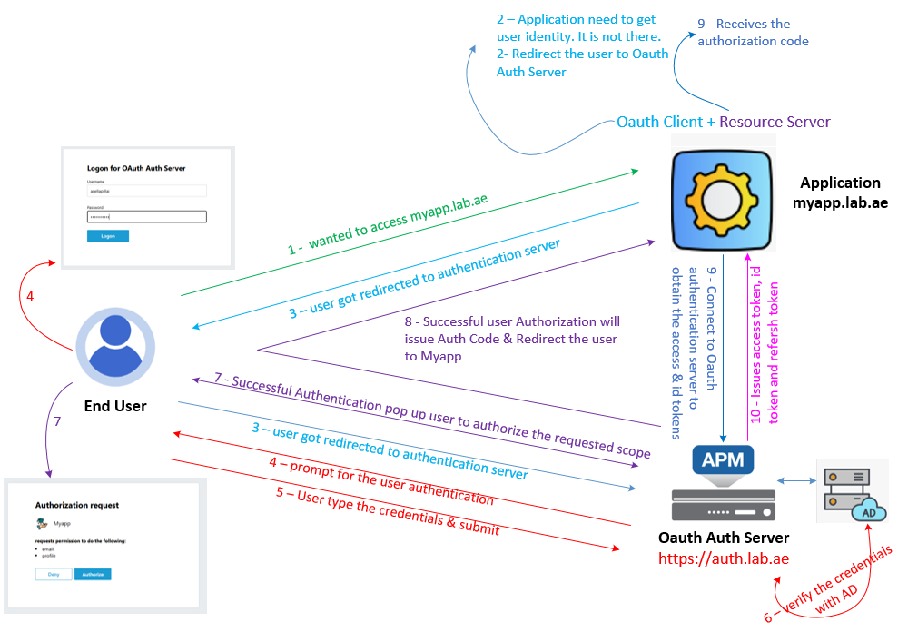
    Step 10: OAuth Authorization Server Issues Access, ID, and Refresh Tokens to the Client
The OAuth Authorization Server validates the authorization request and, upon successful verification, issues an access token, id token and refresh token to oAuth Client.
This token can be either a JWT or Opaque token.
Important note:
  When OpenID Connect is enabled on F5 APM, both the ID token and the access token must be issued as JWTs.
  Opaque access tokens are not supported by APM in OpenID Connect mode.

Slide 16
    Step 10: The OAuth Authorization Server issues an access token, ID token, and optionally a refresh token to the oAuth Client.
    Access Token
      Used by the OAuth client to access protected resources (APIs) on the Resource Server.
      Represents the user’s delegated permissions (scopes).
      Typically, short-lived (e.g., valid for 1 hour).
    ID Token
      Part of OpenID Connect (OIDC) — contains user identity information (e.g., sub, name, email, preferred username) in a JWT format.
      Signed by the Authorization Server to ensure authenticity.
      Used by the client to verify who the authenticated user is.
    Refresh Token
      A long-lived token used by the Oauth Client to obtain a new access token when the current one expires.

Slide 17
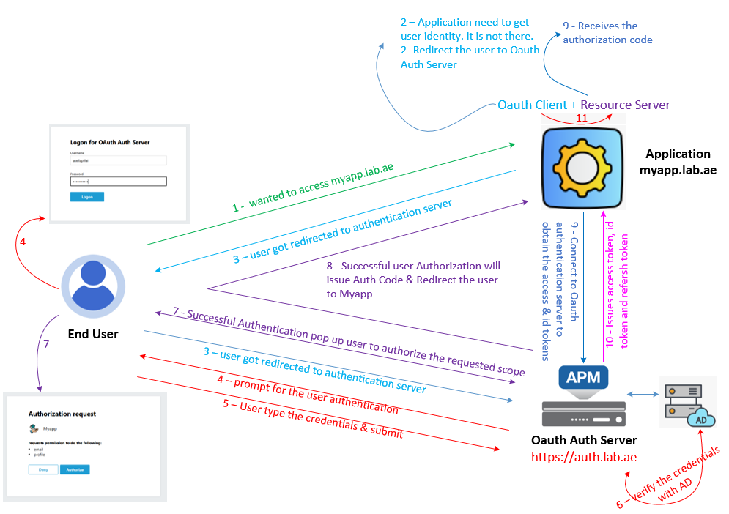
    Step 11: OAuth Client Passes Access Token to OAuth Resource Server
✅ Once the OAuth Client receives the Access Token and ID Token
📤 It sends a request to the OAuth Resource Server to access protected resources
🔁 In our setup, the OAuth Client and Resource Server are the same application.
This is common in modern web applications.

Slide 18
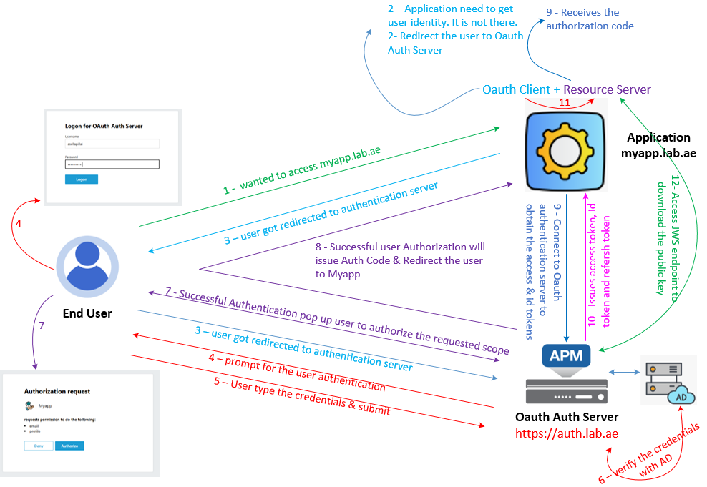
    Step 12: The OAuth Resource Server receives the access token and ID token, then verifies their JWT signatures using the JWS endpoint.
    Oauth resource server receives and checks the tokens.
    It is JWT token - The oAuth Resource Server verifies the JWT signature using the oAuth Authorization Server’s public key.
    This public key is stored at the oAuth Authorization Server’s JWKS endpoint, which must be reachable by the oAuth Resource Server.
https://auth.lab.ae/.well-known/jwks.json

Slide 19
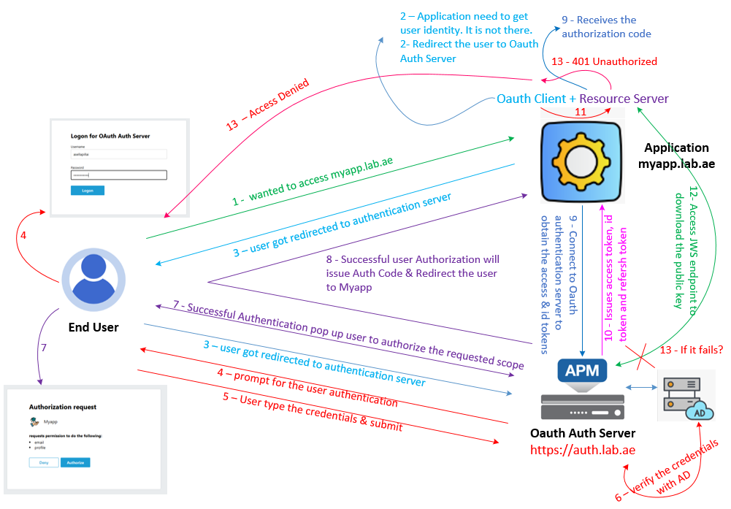
Step 12 : Resource Server → validates tokens to allow the access to protected resources
    JWT Token Verification Fails – 401 Unauthorized / Access Denied
https://auth.lab.ae/.well-known/jwks.json
    If the JWKS endpoint is not reachable:
      The oAuth Resource Server cannot verify the signature of the access token and will respond to the client with 401 Unauthorized.
      Which result access denied to the end user.

Slide 20
    Step 12: Resource Server → validates tokens to allow the access to protected resources
    JWT Token Verification successful – Protected resource access is allowed
https://auth.lab.ae/.well-known/jwks.json
    If the JWKS endpoint is reachable:
      The Resource Server downloads the public key and then validates the token claims:
      iss → must match the Authorization Server (issuer)
      aud → must match the Resource Server (audience)
      exp → ensure the token has not expired
      scope → ensure the token includes the required permissions
    Once all checks pass, the Resource Server processes the request and serves the protected resource.

Slide 21
This concludes Chapter 02, where we discussed how F5 APM functions as an Authorization Server using the OpenID Connect Code Flow.
Please continue watching Chapter 03, where we’ll learn how to configure and test F5 APM as an Authorization Server using OpenID Connect Code flow.
Thank you for watching!
Chapter 02 – F5 APM functions as an Authorization Server using the OpenID Connect Authorization Code Flow

